Slide 1
GENERATING YARA RULES TO DETECT MALWARE
PIP104 PROFESSIONAL PRACTICE-II
VIVA-VOCE
Batch Number:45
Roll Number | Student Name
20201CCS0064 | SANTHOSH G
20201CCS0037 | VIGNESH R
20201CCS0013 | S AAQIB
20201CCS0040 | DHANUSH RAGAENDAR
Under the Supervision of,
Ms.SOUMYA
Assistant Professor
School of Computer Science Engineering & Information Science
Presidency University

Slide 2
Introduction
Yara rules are a powerful tool for identifying and classifying malware based on patterns and characteristics.
They are written in a specific syntax and can be used in various security applications.
Purpose :
It allows security professionals to create custom rules for detecting specific patterns associated with malicious software.
Application Areas :
Widely used in cybersecurity for scanning files, memory, or network traffic to identify potential security threats.

Slide 3
Literature Review
Title of the project : YARA-Signator: Automated Generation of Code-based YARA Rules.(2023)
Summary :
The paper proposes YARA-Signator, a framework for automated generation of code-based YARA rules.
YARA-Signator isolates instruction n-grams (sequences of fixed length instructions) that frequently appear within a malware family but are not found in any other family.
These unique n-grams form the basis for YARA rule strings that can reliably detect and identify malware families.
Drawback :
The approach was only tested on the Malpedia dataset, which mainly contains Windows malware. It's not clear how well it would generalize to other platforms or datasets.

Slide 4
Literature Review
Title of the project: YAMME: a Yara-byte-signatures Metamorphic Mutation Engine(2023 )
Summary:
The paper presents YAMME (Yara-byte-signatures Metamorphic Mutation Engine), an algorithm that employs metamorphic obfuscation techniques to strengthen YARA rules against evasion attempts.
YAMME first rewrites YARA byte-signatures in several equivalent ways, similar to how a metamorphic mutation engine would operate.
It then introduces an optimization phase to compact the strings produced and reduce computational overhead, providing different YARA rule formats.
Drawback :
Potential for increased false positives. Mutating YARA rules in multiple ways increases the search space and risk of capturing benign files/behavior as well. The paper found this effect varied based on the rule format/optimization applied.

Slide 5
Research Gaps Identified YARA-Signator: Automated Generation of Code-based YARA Rules.(2023)
The research gap in this paper is that it identifies the limitations of existing automated signature generation tools and proposes a new framework that aims to address these limitations.
Specifically, the paper highlights the need for automated signature generation techniques that are sensitive and specific, capable of handling malware of any size and file type, and minimize false positive cases.
The proposed framework attempts to bridge this gap by providing a scalable and generic approach to automatic YARA rule-based signature generation, which is more accurate and suitable for practical use in the context of identifying new malware samples while reducing false-positive detection.

Slide 6
Research Gaps Identified YAMME: a Yara-byte-signatures Metamorphic Mutation Engine(2023)
The research gap addressed by this paper is the need for more effective detection techniques to counteract the evasion attempts of malware that use obfuscation techniques.
Specifically, the paper focuses on the limitations of YARA rules in detecting malware that has been obfuscated using metamorphic mutation engines.
The proposed YAMME aims to bridge this gap by perturbing known YARA-byte-signatures to enhance their resilience against obfuscation techniques and improve detection performance.
Therefore, the research gap lies in the need for more robust and adaptive detection mechanisms to combat the evolving sophistication of malware obfuscation.

Slide 7
Proposed Methodology
Scanning Efficiency:
Parallel Processing: Implement parallel processing to enable efficient scanning of large datasets.
Indexing: Create an index of known patterns and signatures for faster lookups during the scanning process. This index accelerates the identification of potential matches.
Prioritization: Develop a system for prioritizing and categorizing YARA rules based on their potential effectiveness. This will help identify the best signature candidates quickly.

Slide 8
Proposed Methodology
User Interface
Intuitive Interface: Design a user-friendly interface that allows users to specify the dataset for analysis, customize rule generation parameters, and review the generated YARA rules.
Rule Management: Provide tools for users to manage and organize the generated rules, enabling them to choose which rules to deploy and when.

Slide 9
Objectives
Automated Rule Generation:
This objective aims to reduce the manual effort and time required for creating YARA rules, thereby increasing the efficiency of signature generation.
2.User-Friendly Interface:
This objective is to design a user-friendly platform that simplifies the process of specifying file sets, initiating rule generation, and analyzing results.

Slide 10
Objectives
3.Validation and Testing:
This includes testing the signatures on diverse malware samples and benchmarking against known datasets.
4.Cost-Efficiency:
An objective is to offer a cost-efficient solution that helps organizations reduce manual labor and resource costs associated with YARA rule creation and malware analysis.

Slide 11
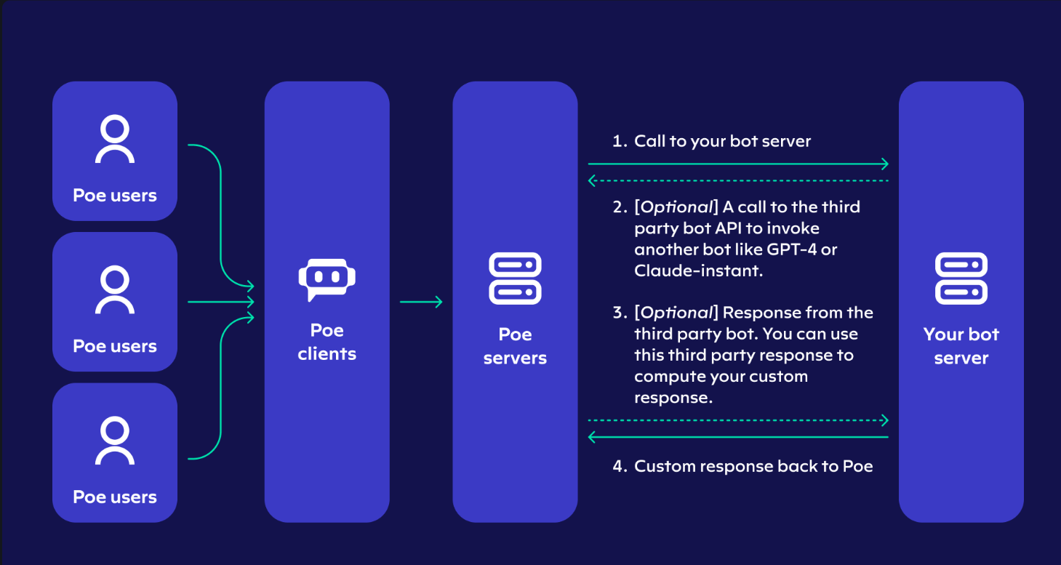
System Design & Implementation

Slide 12
Timeline of Project
Stage of project | 12-10-2023 | 05-12-2023 | 22-12-2023
Confirmation of Project title. (review 0)
Hard copy of project (review 1)
50% Demonstration (review 2)
100% Demonstration (review 3)

Slide 13
Outcomes / Results Obtained
Automated Rule Generation:
This will result in a significant reduction in the time and effort required to create YARA signatures, allowing security professionals to keep pace with evolving malware threats efficiently.
2. Time-Efficient Scanning:
This will enable security analysts to swiftly identify the best signature candidates, thereby improving the efficiency of malware detection and reducing the time required for threat assessment.

Slide 14
Outcomes / Results Obtained
3.Generic YARA Rules:
This is expected to lead to improved malware detection and the ability to catch a broader range of malware variants.
4. Enhanced Security:
This will result in better protection against evolving threats and a reduced risk of false negatives.
5. Reduced Manual Workload:
This frees up valuable time and resources that can be better utilized for other critical security tasks.

Slide 15
Conclusion
In conclusion, YARA rules represent a powerful and adaptable tool in the cybersecurity arsenal.
Their precision, community-driven nature, and integration capabilities make them a valuable asset in the ongoing battle against cyber threats.
The cybersecurity community, combined with the effectiveness of YARA rules, will play a pivotal role in securing digital environments.

Slide 16
References
YARA Official Documentation: The official documentation for YARA (https://yara.readthedocs.io/en/stable/) is a valuable resource for understanding the YARA language, signature creation, and usage.
Academic Journals and Conferences: Look for academic papers, articles, and conference papers related to malware detection, signature generation, and YARA rules. Journals like the Journal of Computer Virology and Hacking Techniques and conferences like the ACM Conference on Computer and Communications Security often publish research in this area.
Cybersecurity Research Organizations: Check the publications and reports from cybersecurity research organizations like Symantec,

Slide 17
References
Kaspersky Lab, McAfee, and others. They often share insights into malware detection techniques.
Online Forums and Communities: Websites and forums like the YARA Rules Project (https://github.com/Yara-Rules/rules) can be useful for finding discussions, tutorials, and examples related to YARA rules and signature creation.

Slide 18
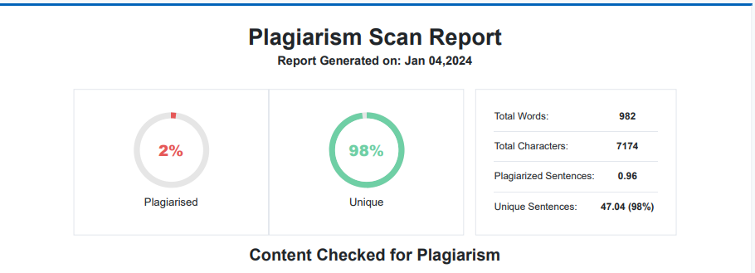
Publication Details

Slide 19

Thank You

